Slide 1



Zernike Wavefront Sensor for Adaptive Optics
Katie Twitchell
Arizona NASA Space Grant Symposium, 22 April 2023
Mentor: Dr. Sebastiaan Haffert, Extreme Wavefront Control Lab, Steward Observatory

Slide 2
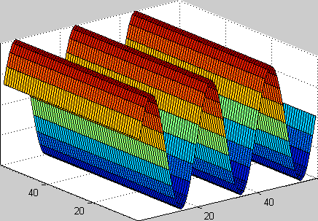
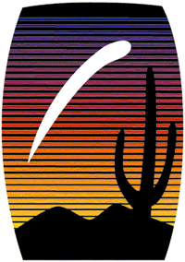

Background
What is a wavefront?
  Light is an electromagnetic wave & therefore exhibits wave properties
  Light coming from a very distant point source (e.g. a star) reaches Earth as a plane wave
Herbert Weidner

Slide 3
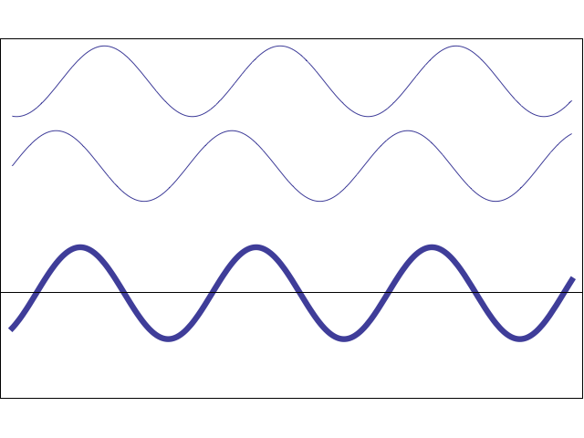

Background
What is light interference?
  When two light waves interfere, phase variations get turned into intensity (brightness) variations
  This can be constructive (brighten image) or destructive (darken image)
The intensity of the sum is related to the phase difference $(Δφ)$ between the two waves
  $I_{total}=I_{1}+I_{2}+2\sqrt{I_{1}I_{2}}∗cos⁡(Δφ)$
D. Russell (2014)

Slide 4

Motivation
Ground based telescopes
  We want images that are sharp, especially if we want to detect something distant & small like an exoplanet
  The atmosphere introduces what are called aberrations
    Light waves get bent, shifted by turbulence in the atmosphere
    Wavefronts are no longer planes
    This translates to blurry images

Slide 5
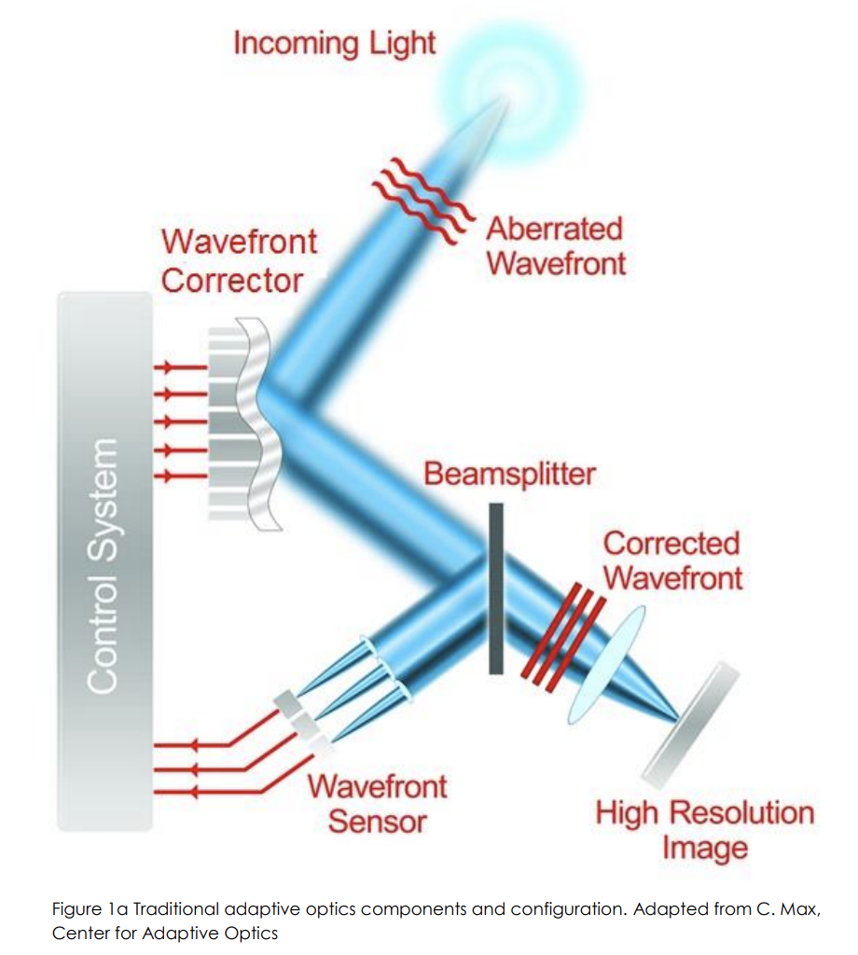
Adaptive Optics (AO)
C. Max (2014)
Notes:
We can use AO to correct for atmospheric errors and regain the original wavefront
Light comes into system, wavefront sensor measures aberrations while science camera takes images
Computer decides how the Deformable Mirror will shape itself to undo aberrations
Mirror changes shape, loop repeats (very fast)

Slide 6
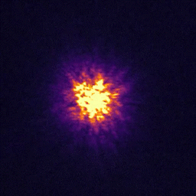
Adaptive Optics (AO)

Slide 7
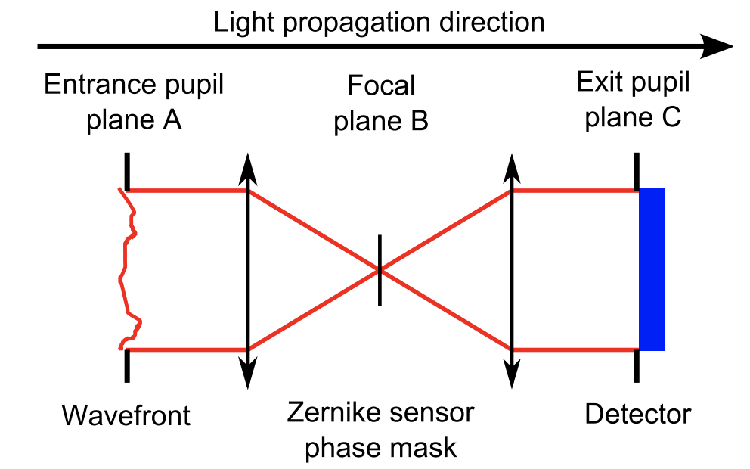
The Zernike Wavefront Sensor
A Zernike Wavefront Sensor (ZWFS) works using interference
Input wavefront is focused down to a spot that passes through the phase mask
Spot is then imaged onto a camera detector
M. N’Diaye (2013)

Slide 8
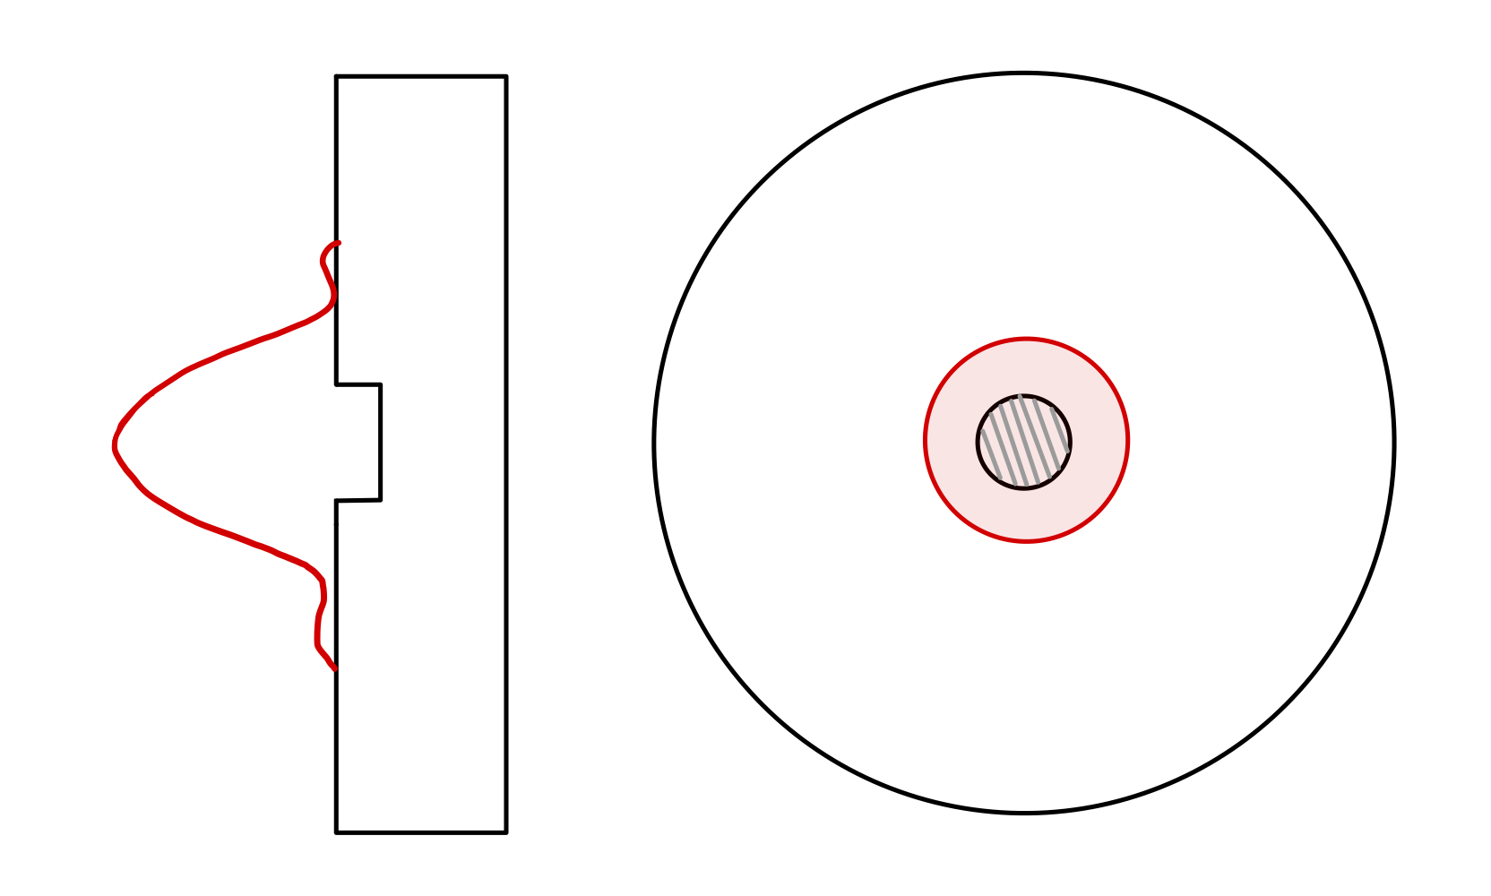
The Zernike Mask
Splits an incoming light beam into two parts, then phase shifts one of them with respect to the other
Interference equation
  We can use the intensity of the light detected by the camera at each pixel to calculate the relative phase of the light that came in
(Not to scale—dot is 50 μm in diameter and 350 nm deep)

Slide 9
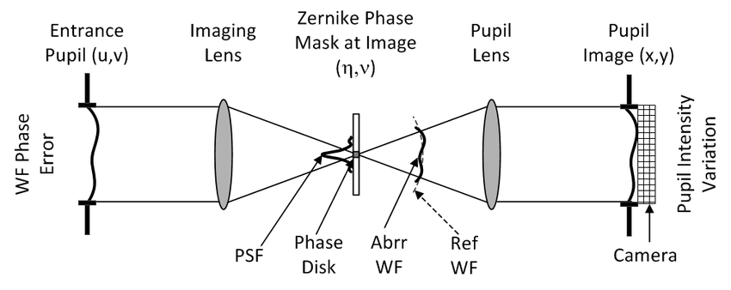
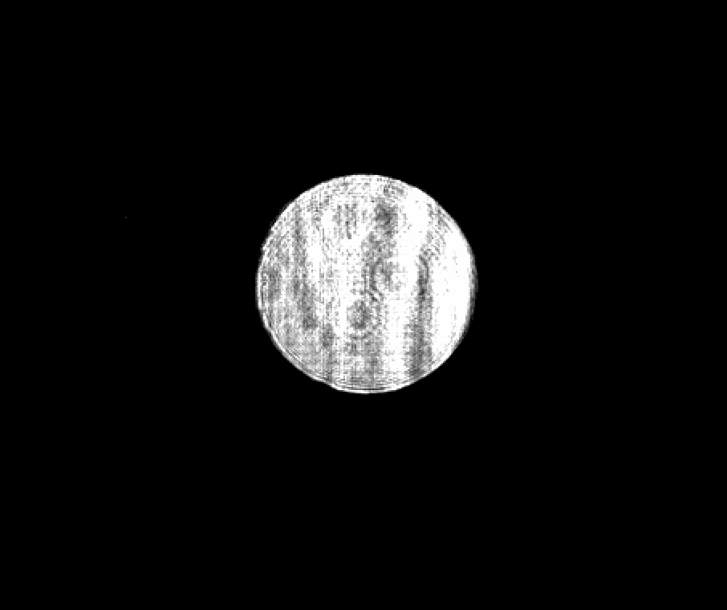
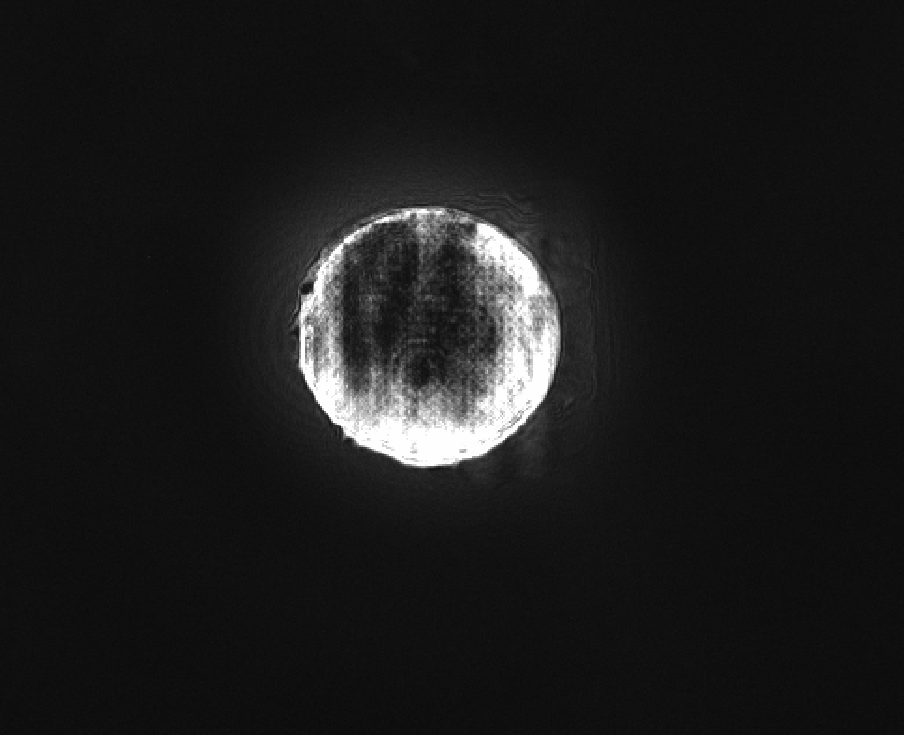
Images from the ZWFS
J. Shields (2015)
Without Phase Mask
After Adding Phase Mask

Slide 10
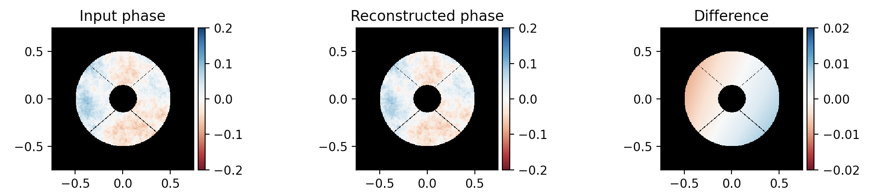
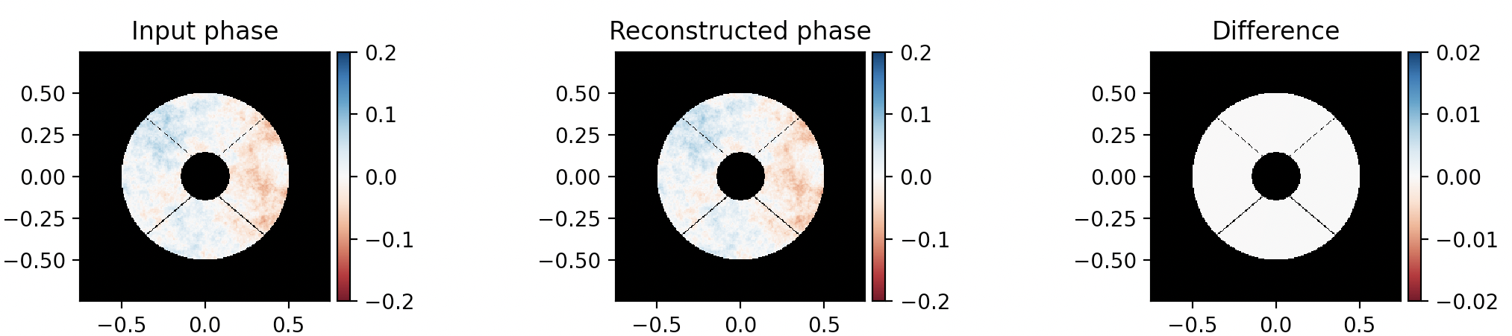
Simulated Wavefront Reconstruction
Used a non-linear reconstruction algorithm with a simulated reference beam
Iterated 1x
Iterating the algorithm leads to more accurate results
Iterated 5x

Slide 11
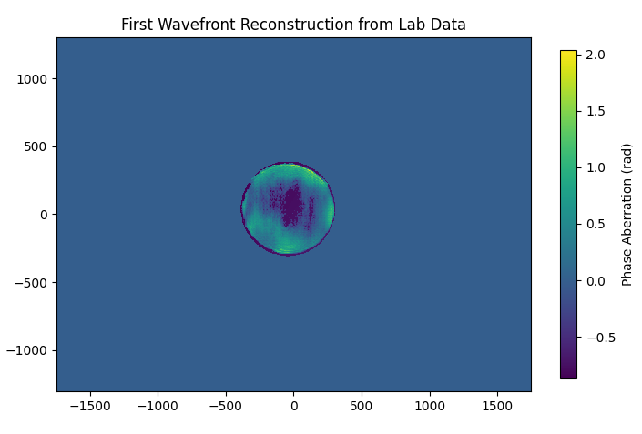
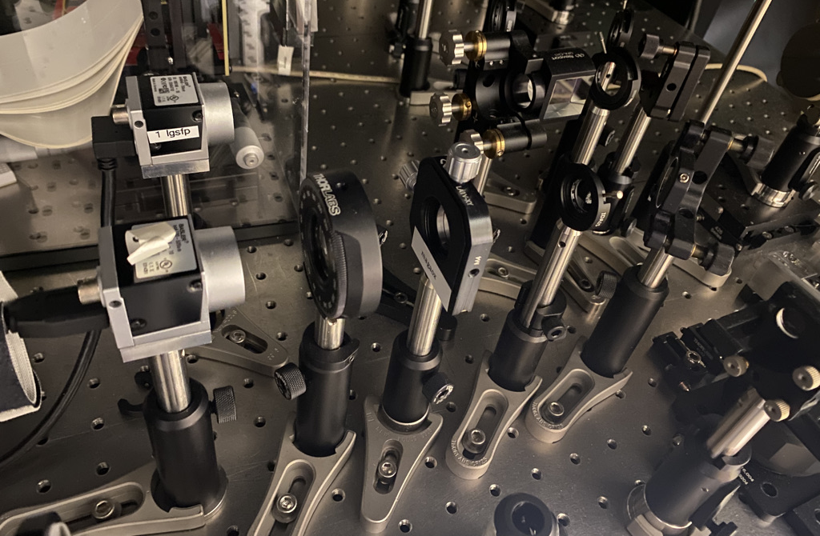
Laboratory Setup & Results
The system is set up on the Comprehensive Adaptive Optics and Coronagraph Test Instrument (CACTI)
Camera
Zernike Mask

Slide 12
Conclusions/Next Steps
What sets the Zernike Wavefront Sensor apart?
  High spatial frequency
    Can create very detailed wavefront reconstructions
  Sensitive to very small phase variations
What’s next?
  Measure the accuracy of the sensor in the laboratory
    Sending known phase patterns via the DM to see how well the reconstructor can recreate them

Slide 13
Acknowledgements
My mentor Dr. Haffert, Avalon McLeod, all other members of the XWCL
Arizona Space Grant

Slide 14
Thank You!

